Slide 1
Artist Branding Survey

Slide 2
Goal:
Find Nathalie’s target audience distributing this survey for both international and Dutch people, students or working professionals, in any age.

Slide 3
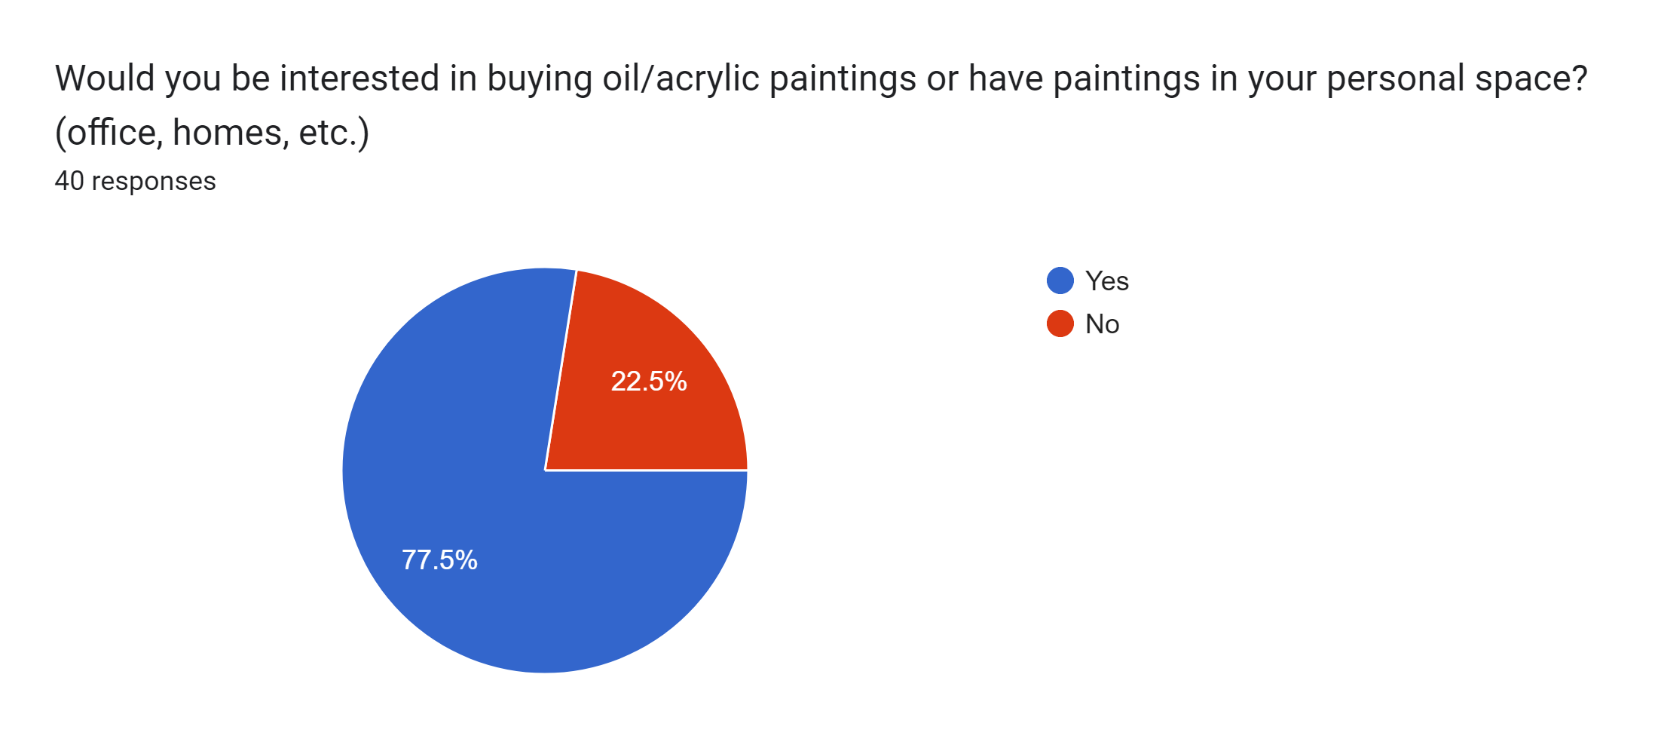
Results

Slide 4
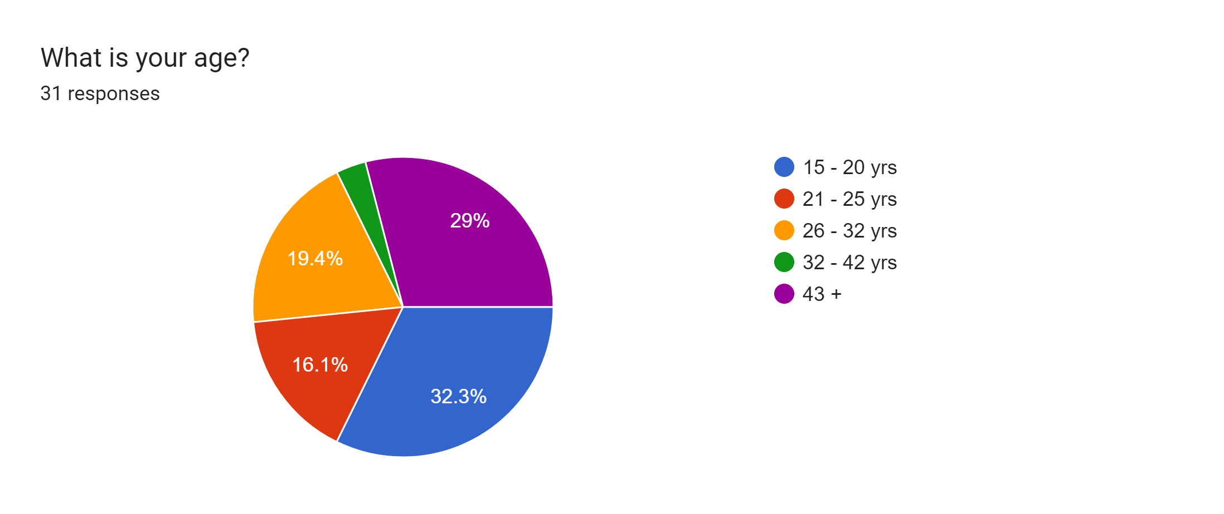
Results:

Slide 5
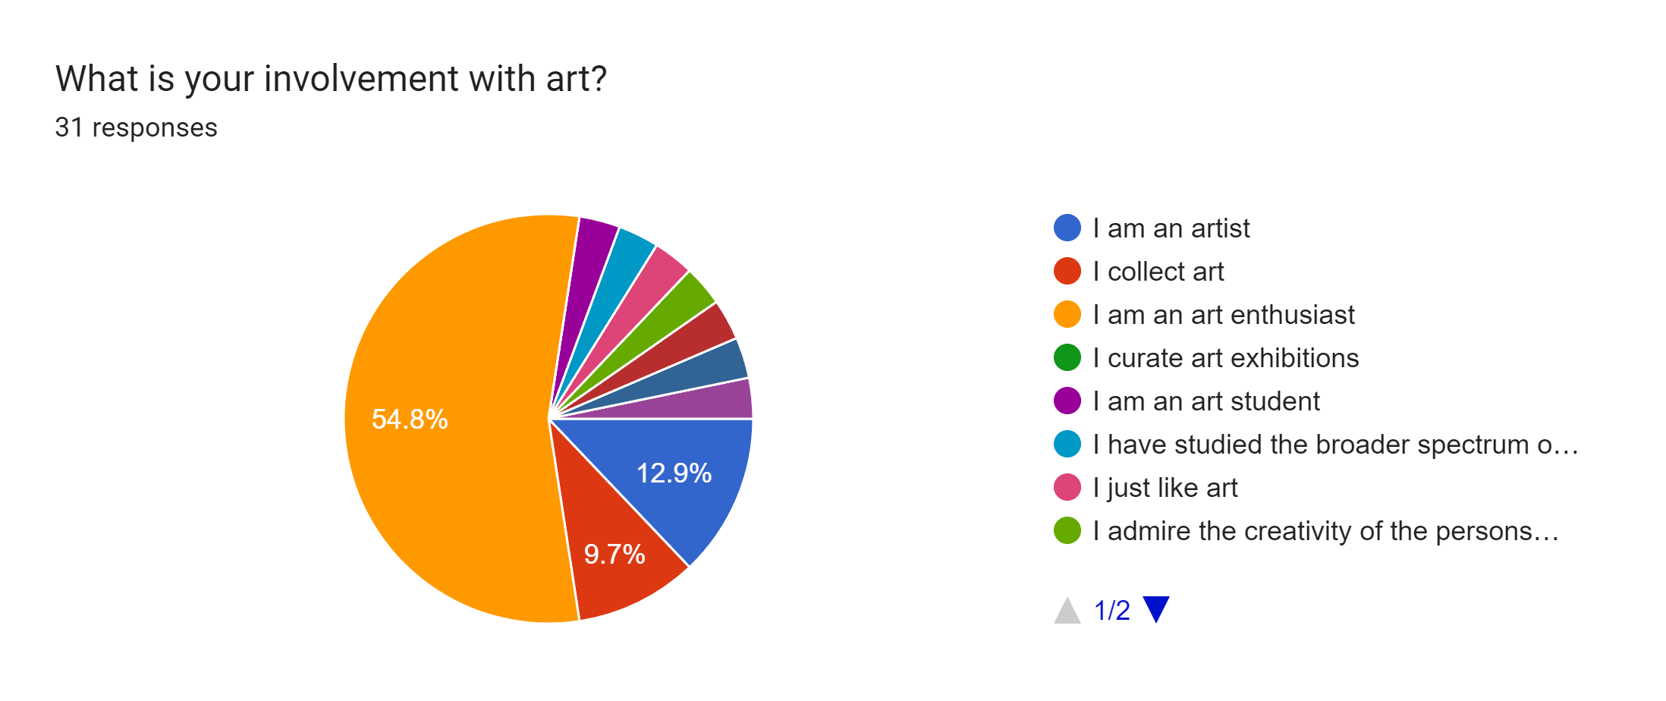
Results:

